Slide 1
Song Recommender ANALYSIS
Group 2

Slide 2
TABLE OF CONTENTS
01
02
03
SECTION
Quick overview of the original model
SECTION
Enhancements made and their benefits
SECTION
Findings from Data exploration

Slide 3
TABLE OF CONTENTS
04
05
06
SECTION
Comparison of different clustering algorithms used
SECTION
How user feedback can be incorporated into the model in the future and its impact
SECTION
Other future enhancements that can be made to the model

Slide 4
SECTION
01.
Marketing
2XXX
Overview

Slide 5
IN A NUTSHELL, THE MODEL IS SUPPOSED TO…
RECOMMEND
THIS HAPPENS
FINAL OUTPUT
Songs to users based on their favorite songs
By identifying the cluster that most of the user's favorite songs belong to
Of code is a list of song recommendations

Slide 6
SECTION
O2.
Enhancements

Slide 7
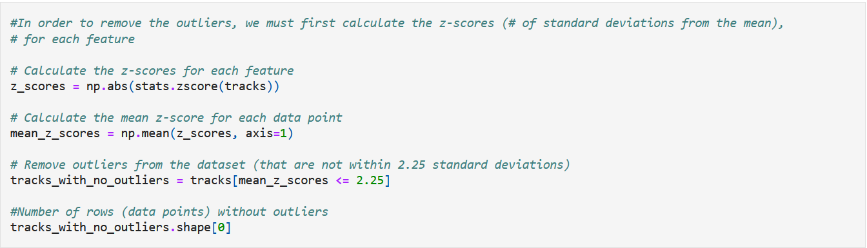
Enhancements (Outliers)
We looked for a way to handle the outliers on the model, in order to do this we decided to delete the outliers:

Slide 8
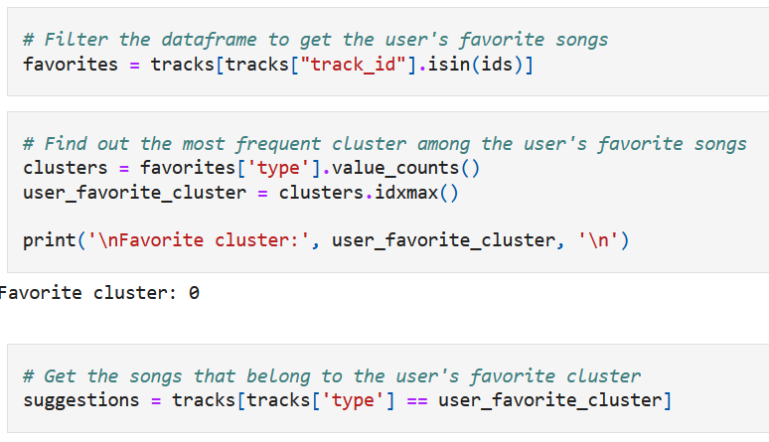
Enhancements (User Favorites)
We made the user able to create a cluster that inputs their favorite songs.

Slide 9
SECTION
O3.
Findings

Slide 10
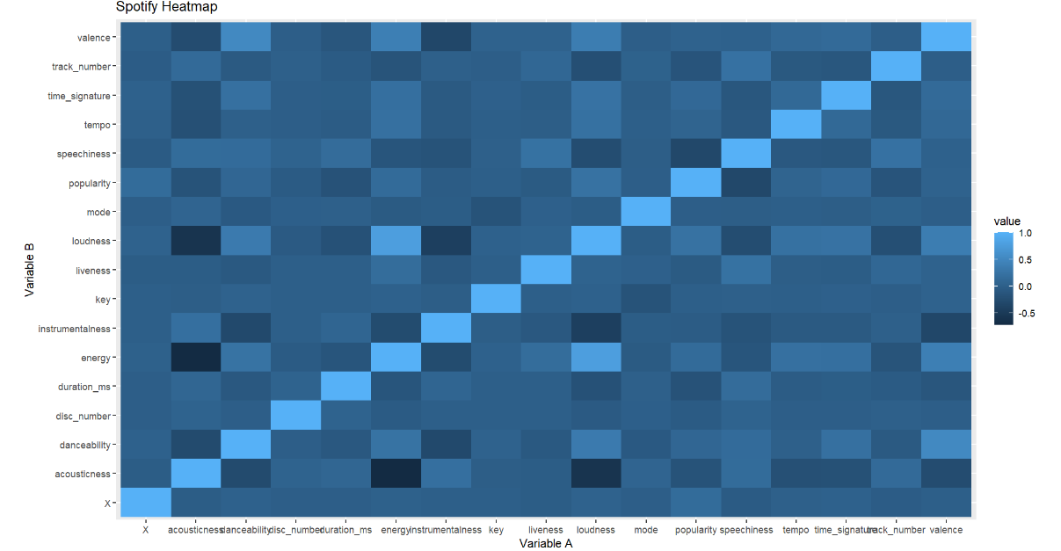
Heatmap
This tells us…
Increase energy of music tends to have less acousticness as well as loudness and acousticness (negative correlation)
The louder a song is the more energy it has (positive correlation)
Strongest correlations are seen to be…
Acousticness and Energy (-)
Loudness and Acousticness(-)
Loudness and Energy (+)

Slide 11
SECTION
O4.
Clustering Comparison

Slide 12
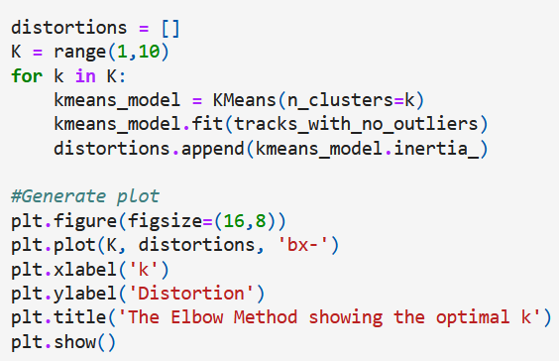
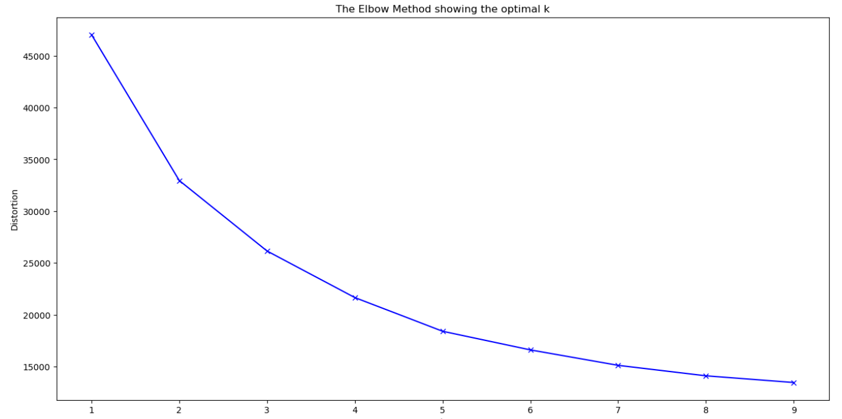
Elbow Technique
For optimizing the number of clusters, we looked at two techniques: elbow technique and silhouette coefficient.
For this method, we must make a chart to find the "elbow" (number of optimal clusters)

Slide 13
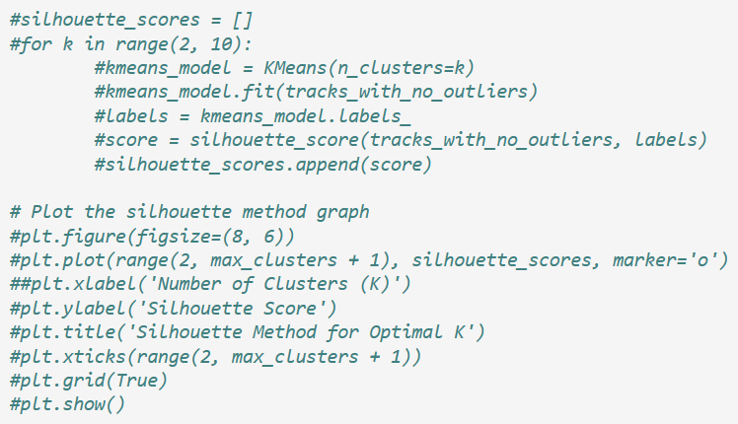
Silhouette Coefficient
For optimizing the number of clusters, we looked at two techniques: elbow technique and silhouette coefficient.
Calculates silhouette scores (measure of how well separated the clusters are and how well each data point is assigned to a cluster).
Higher values on a scale of [-1, 1] indicate better clustering.
Downside!!
computationally expensive

Slide 14
OTHER CONSIDERATIONS
1. KMedians:
Calculates the centroid of each cluster as the MEDIAN of the data points
Thus, it is less sensitive to outliers in a data set, which in turns enables better performance.
2. DBSCAN:
Does not require specifying the # of clusters in advance
Makes the process of clustering significantly more efficient and less subjective
DBSCAN handles outliers as noise, which prevent the outlier issue present in KMeans.

Slide 15
SECTION
O5.
User Feedback Incorporation

Slide 16
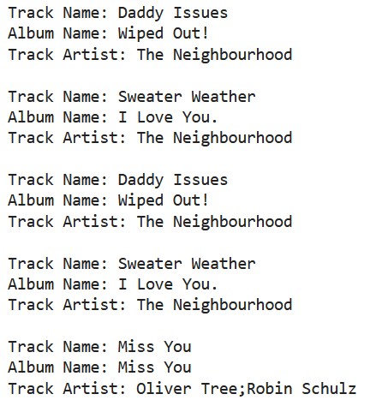
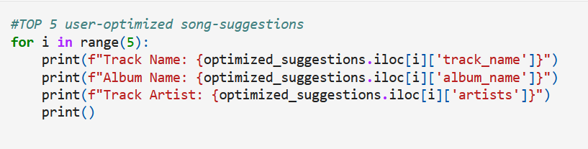
Popularity
We can add a feature that makes song suggestions based on the level of popularity of certain songs.

Slide 17
SECTION
O6.
Future Enhancements

Slide 18
Possible Future Enhancements
Genre Data
Contextual Awareness
Novelty and Surprise
Allows us to create more correlations for better recommendations
Listener's mood, location, weather, and activity
May start to breach into ethical issues
Suggesting songs that the user might not have encountered otherwise

Slide 19
THANK YOU FOR LISTENING!

